Slide 1

Logical Database Design and the Relational Model
Chapter # 05

Slide 2
Logical Database Design and the Relational Model
ER-to-Relational Mapping Algorithm
Step 1: Mapping of Regular Entity Types
Step 2: Mapping of Weak Entity Types
Step 3: Mapping of Binary 1:1 Relation Types
Step 4: Mapping of Binary 1:N Relationship Types.
Step 5: Mapping of Binary M:N Relationship Types.
Step 6: Mapping of Multivalued attributes.
Step 7: Mapping of N-ary Relationship Types.
Mapping EER Model Constructs to Relations
Step 8: Options for Mapping Specialization or Generalization.
Step 9: Mapping of Union Types (Categories).

Slide 3
Step 1: Mapping of Regular Entity Types.
For each regular (strong) entity type E in the ER schema, create a relation R that includes all the simple attributes of E.
Choose one of the key attributes of E as the primary key for R.
If the chosen key of E is composite, the set of simple attributes that form it will together form the primary key of R

Slide 4
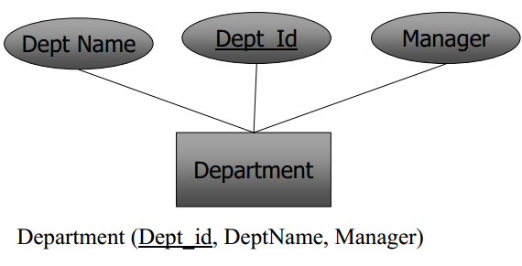
Step 1: Mapping of Regular Entity Types.

Slide 5

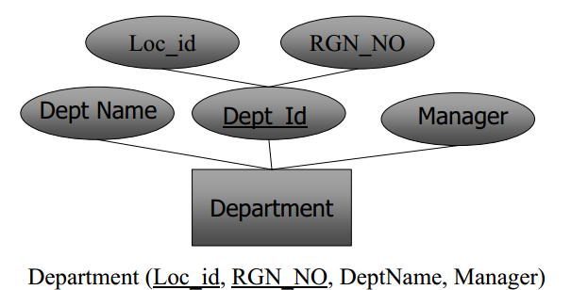
Step 1: Mapping of Regular Entity Types.

Slide 6
Step 2: Mapping of Weak Entity Types
For each weak entity type W in the ER schema with owner entity type E, create a relation R & include all simple attributes (or simple components of composite attributes) of W as attributes of R.
Also, include as foreign key attributes of R the primary key attribute(s) of the relation(s) that correspond to the owner entity type(s).
The primary key of R is the combination of the primary key(s) of the owner(s) and the partial key of the weak entity type W, if any.

Slide 7
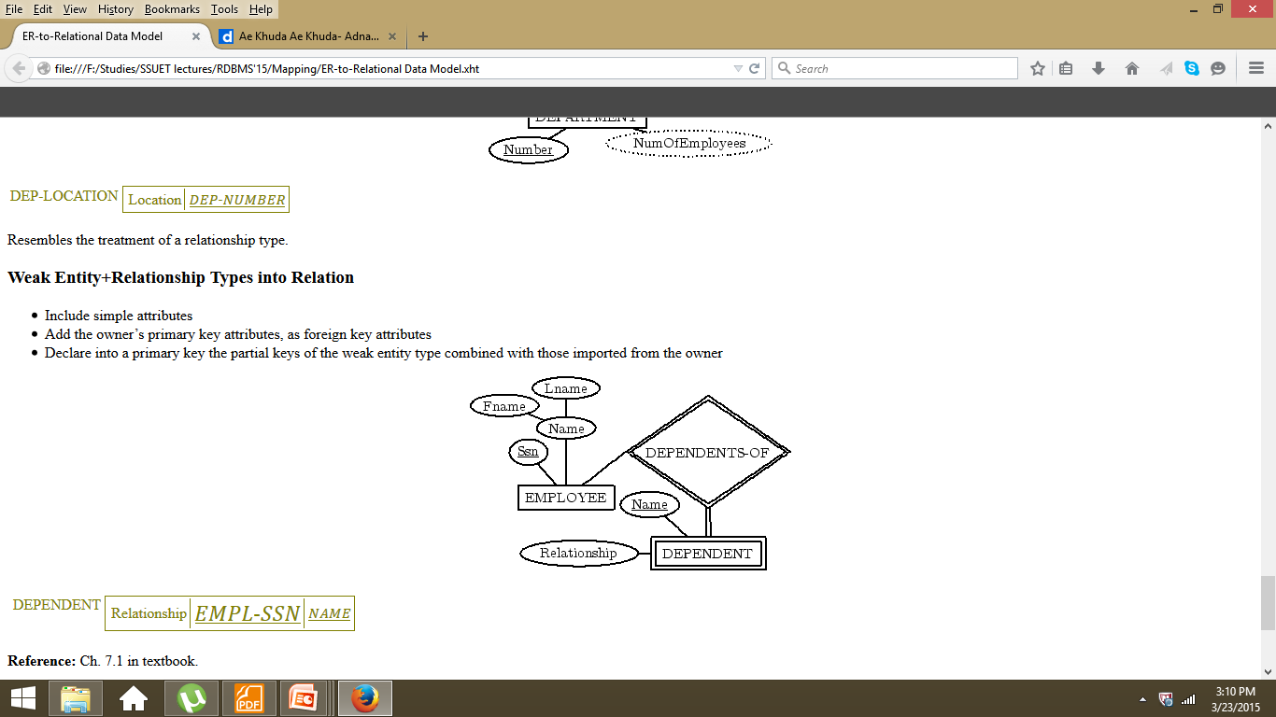
Step 2: Mapping of Weak Entity Types

Slide 8
Step 3:For each binary 1:1 relationship type R
Identify the relations S and T that correspond to the entity types participating in R. Choose one of the relations, say S, and include as foreign key in S the primary key of T.
It is better to choose an entity type with total participation in R in the role of S
.
Include the simple attributes of the 1:1 relationship type R as attributes of S.
If both participations are total, we may merge the two entity types and the relationship into a single relation.

Slide 9
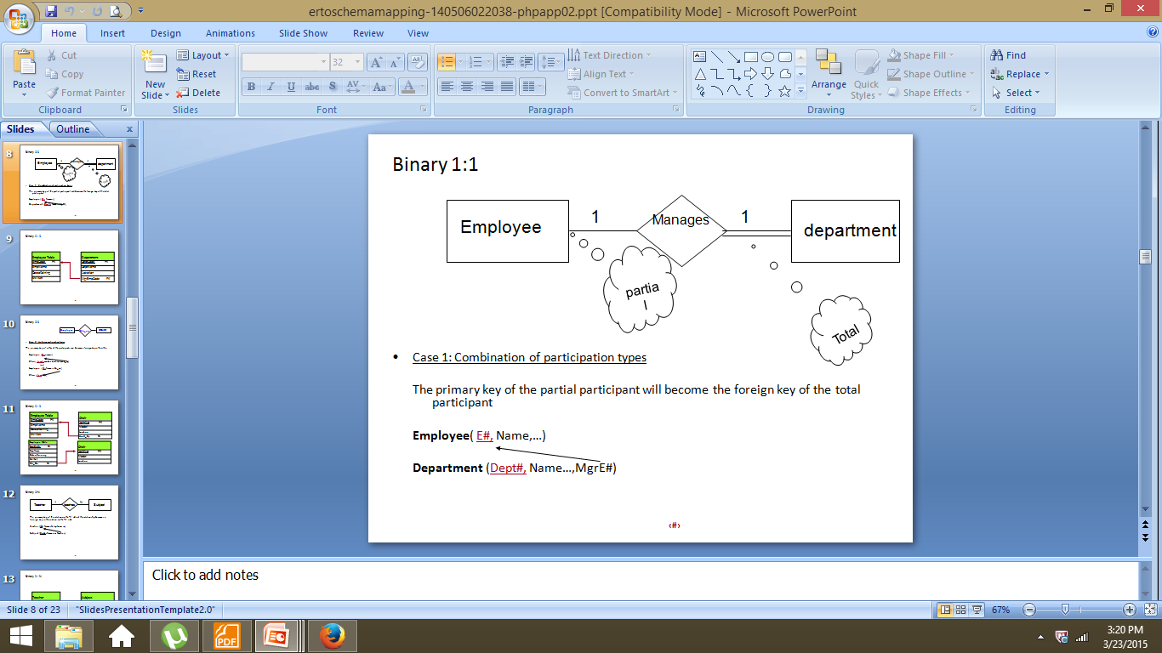
Step 3:For each binary 1:1 relationship type R

Slide 10
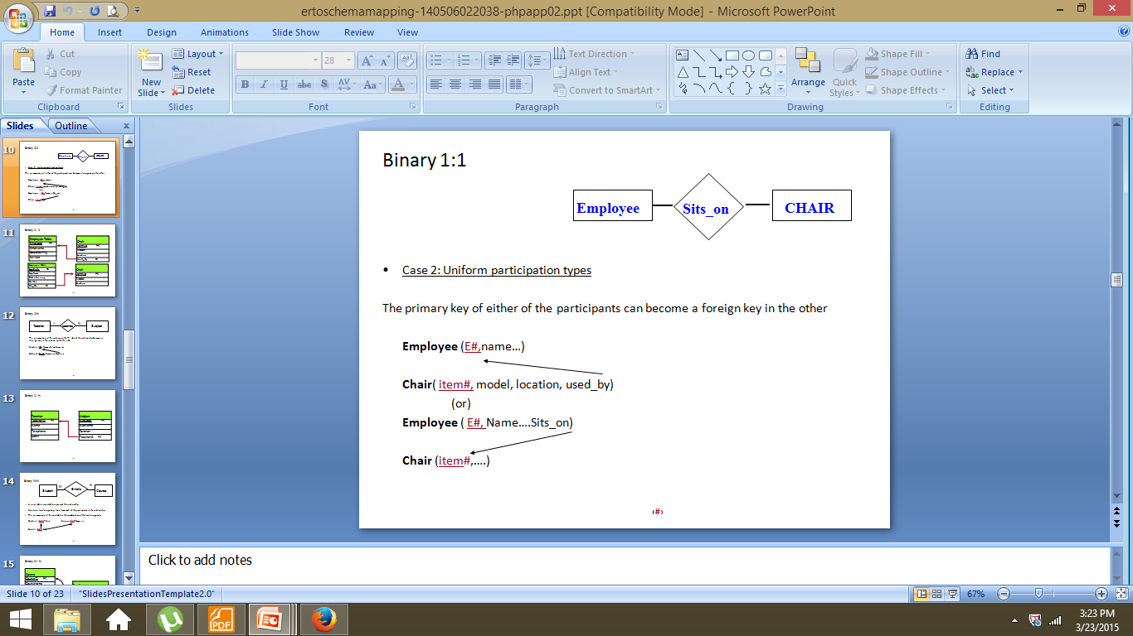
Step 3:For each binary 1:1 relationship type R

Slide 11
Step 3:For each binary 1:1 relationship type R
Manages(Proj_id,Man_id,Start-date)
Start-date
Man_Id
Proj_id
Manages
1
1
Manager
Project

Slide 12
Step 4:For each regular binary 1:N relationship type
Identify the relation S that represents the participating entity type at the N-side of the relationship type.
Include as foreign key in S the primary key of the relations T that represents the other entity type participating in R.
Include any simple attributes of the 1:N relationship type as attributes of S.

Slide 13
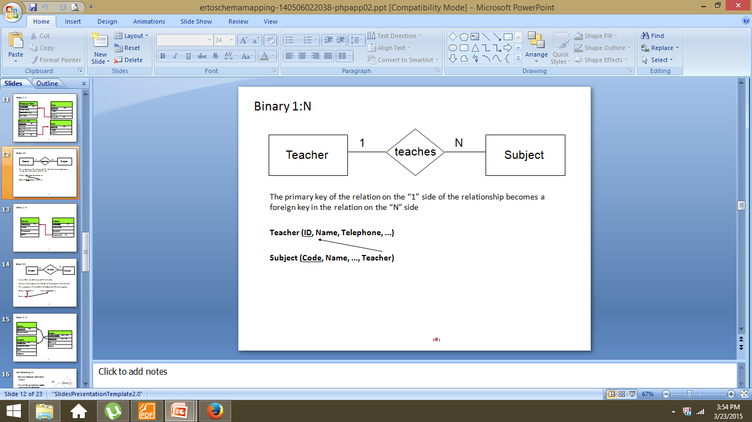
Step 4:For each regular binary 1:N relationship type

Slide 14
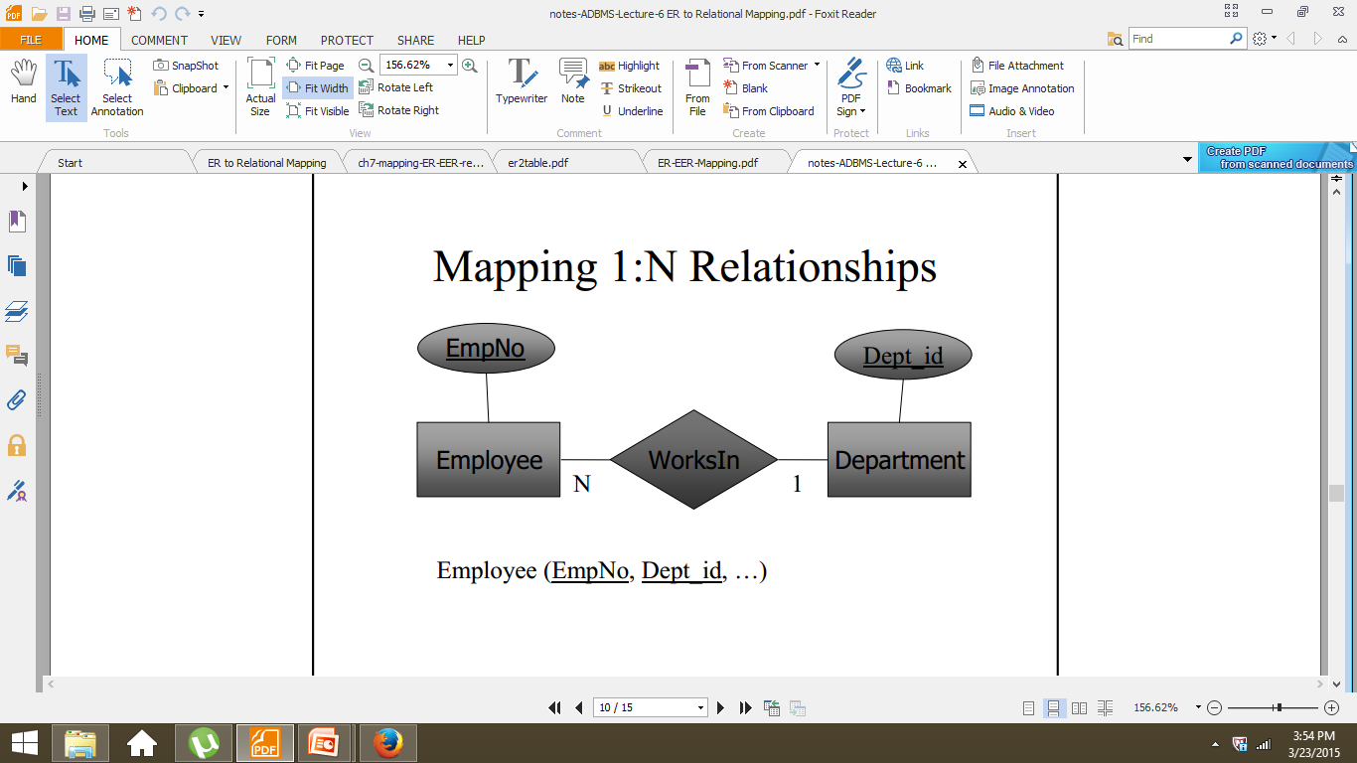
Step 4:For each regular binary 1:N relationship type

Slide 15
Step 5:For each binary M:N relationship type R
Create a new relation S to represent R.
• Include as foreign key attributes in S the primary keys of the relations that represent the participating entity types; their combination will form the primary key of S.
• Also, include any simple attributes of the
M:N relationship type as attributes of S.

Slide 16

Step 5:For each binary M:N relationship type R

Slide 17
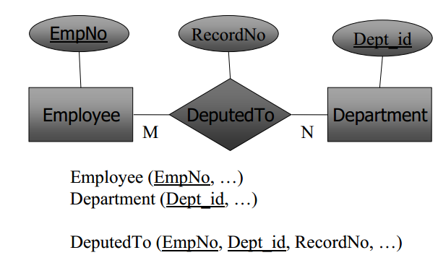
Step 5:For each binary M:N relationship type R

Slide 18
Step 6:For each multi-valued attribute A
Create a new relation R that includes
an attribute corresponding to A plus the primary key attribute K (as a foreign key in R) of the relation that represents the entity type or relationship type that has A as an attribute.
The primary key of R is the combination of A and K. If a multi-valued attribute is composite, we include its components.

Slide 19
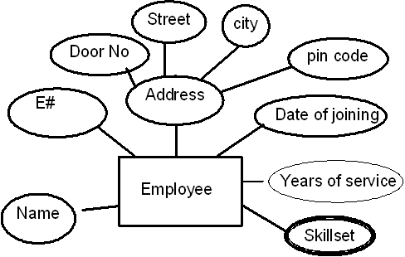
Step 6:For each multi-valued attribute A
Employee (E#, Name, Door_No, Street, City, Pincode, Date_Of_Joining)
Emp_Skillset( E#, Skillset)

Slide 20
Step 7:For each n-ary relationship type R, n>2
Create a new relation S to represent R.
Include as foreign key attributes in the S the primary keys of the relations that represent the participating entity types.
Also include any simple attributes of the n ary relationship types as attributes of S.
The primary key for S is usually a combination of all the foreign keys that reference the relations representing the participating entity types.

Slide 21
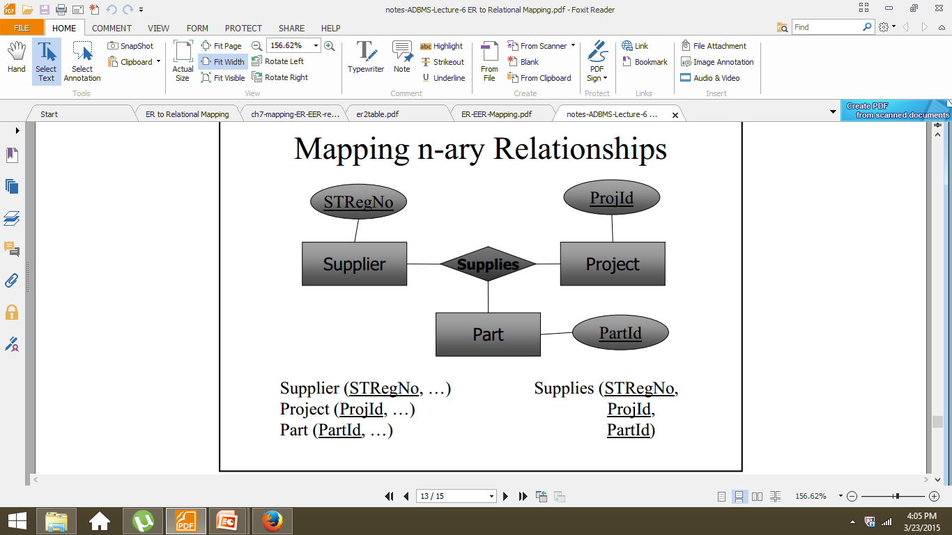
Step 7:For each n-ary relationship type R, n>2

Slide 22
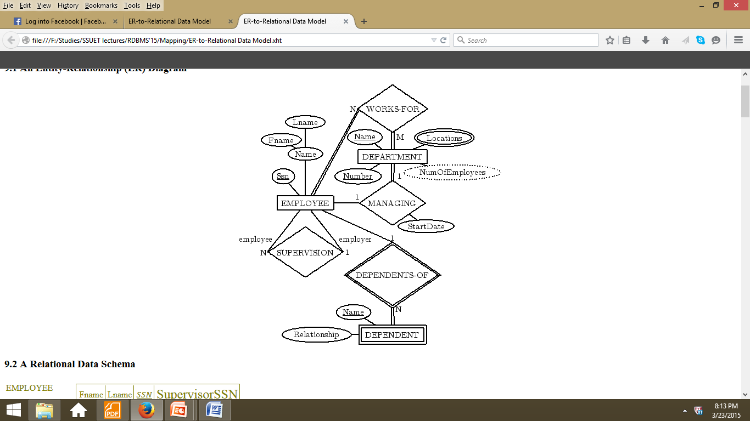

Slide 23
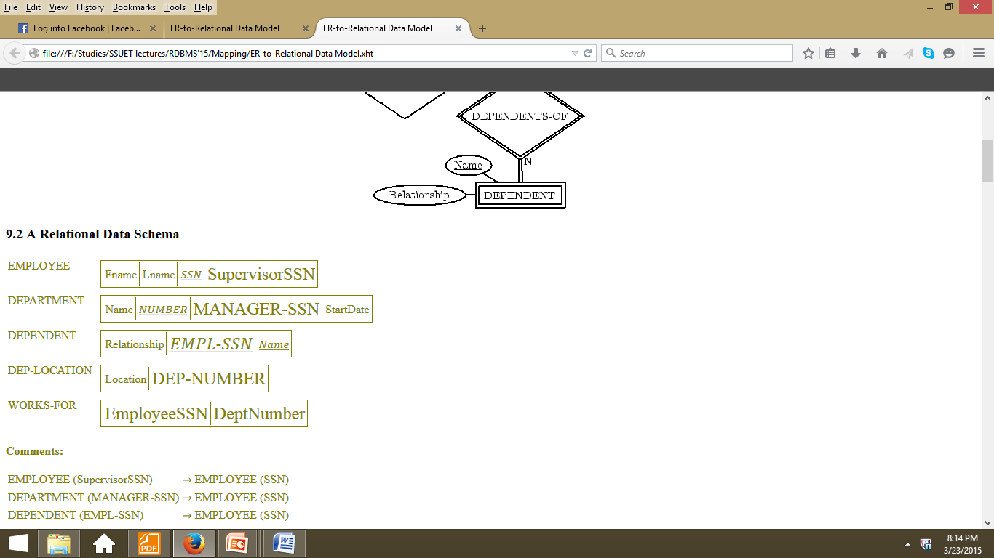

Slide 24
ER Model Relational Model
Entity type- “Entity” relation
1:1 or 1:N relationship type -Foreign key (or “relationship” relation)
M:N relationship type -“Relationship” relation and two foreign keys
n-ary relationship type -“Relationship” relation and n foreign keys
Simple attribute -Attribute
Composite attribute- Set of simple component attributes
Multivalued attribute- Relation and foreign key

Slide 25
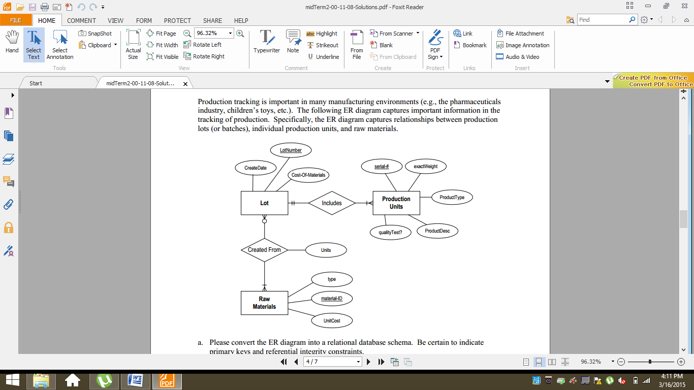
Example1

Slide 26
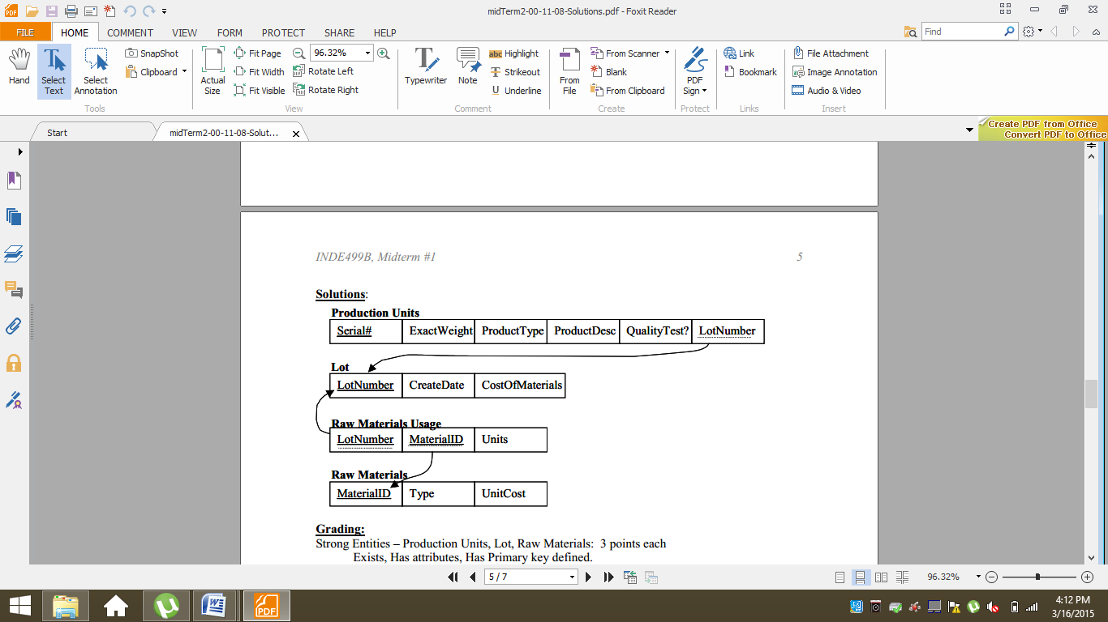
Example1

Slide 27
EER to Relational Mapping
Step 8:To convert each super-class/subclass relationship into a relational schema you must use one of the four options available.
Let C be the super-class,
K its primary key and
A1, A2, …, An its remaining attributes and
let S1, S2, …, Sm be the sub-classes.

Slide 28
Option 8A (multiple relation option)
Create a relation L for C with attributes Attrs (L) = {K, A1, A2, …, An} and PK(L) = K.
Create a relation Li for each subclass Si, 1 <i < m, with the attributes
ATTRS(Li) = {K} U {attributes of Si} and PK(Li) = K.
This option works for any constraints: disjoint or overlapping; total or partial.
Form a table for the superclass and form a table or each subclass. Include the primary key attributes of the superclass in each such table.
Example:
Employees(SocialSN, Name, Address)
Hourly_Emps(SocialSN, Hours, Wages)
Contract_Emps(SocialSN, ContractNo

Slide 29
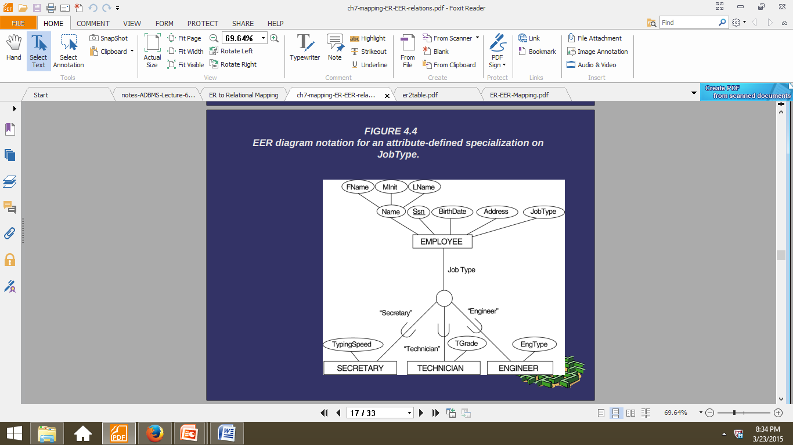
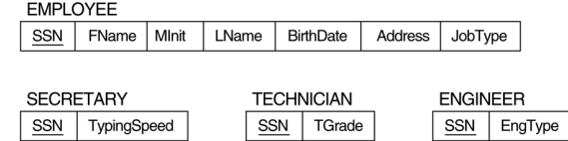
Option 8A (multiple relation option)

Slide 30
Option 8B (multiple relation option)
Create a relation Li for each subclass Si, 1 <i < m, with ATTRS(Li) = {attributes of Si} U {K, A1, A2, …, An}PK(Li) = K
This option works well only for disjoint and total constraints.
• If not disjoint, redundant values for inherited attributes.
• If not total, entity not belonging to any sub-class is lost.
Form a table for each subclass and include allattributes of the superclass.
Hourly_Emps(SocialSN, Name, Address, Hours, Wages)
Contract_Emps(SocialSN, Name, Address, Contractno)
Method 2 has no table for the superclass EMPLOYEES.

Slide 31
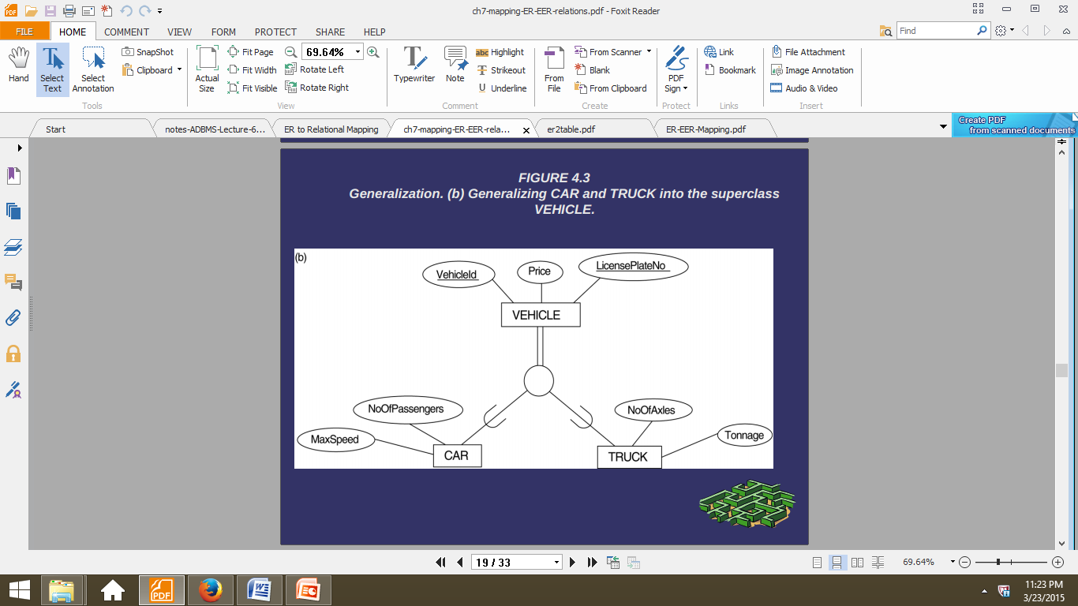
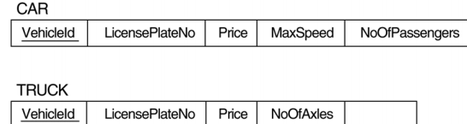
Option 8B (multiple relation option)

Slide 32
Option 8C: Single relation with one type attribute
Create a single relation L with attributes Attrs(L) = {k,a1,…an} U {attributes of S1} U…U {attributes of Sm} U {t} and PK(L) = k.
The attribute t is called a type (or discriminating) attribute that indicates the subclass to which each tuple belongs
Use null values
Employees(SocialSN, Name, Address,Hours, Wages, ContractNo)
Hourly employees will have a null value for ContractNo
.
Contract employees will have null values for Hours andWages

Slide 33
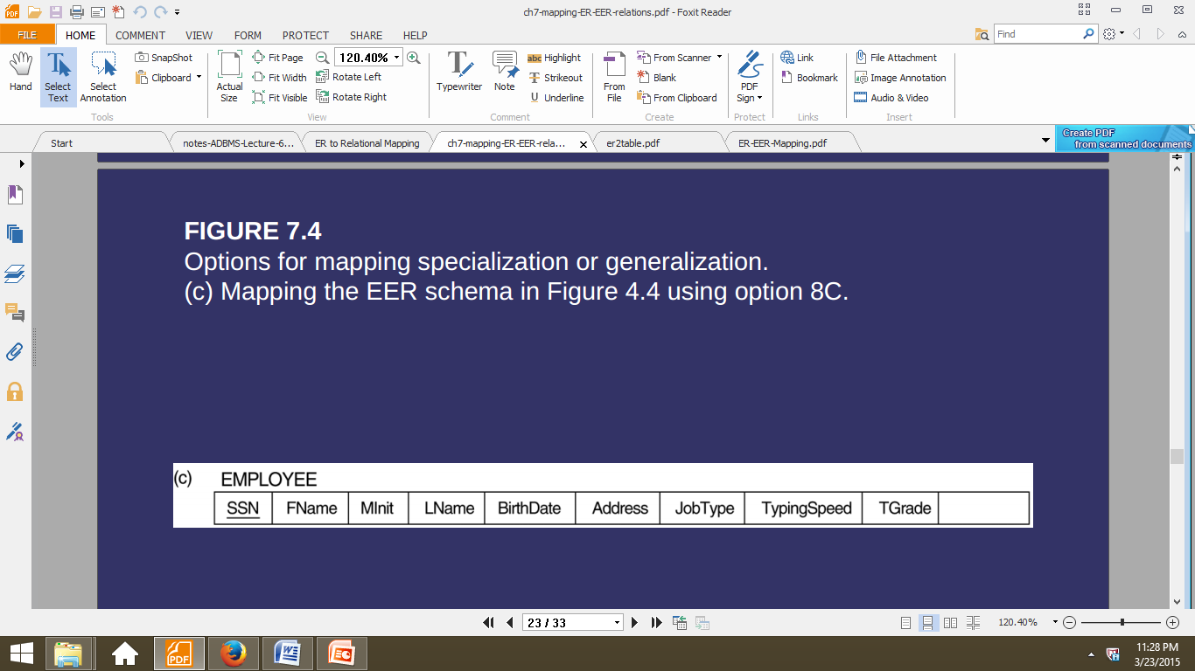
Option 8C: Single relation with one type attribute

Slide 34
Option 8D: Single relation with multiple type attributes
Create a single relation schema L with attributes Attrs(L) = {k,1,…an} U {attributes of S1} U{attributes of Sm} U {t1, t2,…,tm} and PK(L) = k. Each ti, 1 < I < m, is a Boolean type attribute indicating whether a tuple belongs to the subclass Si.

Slide 35
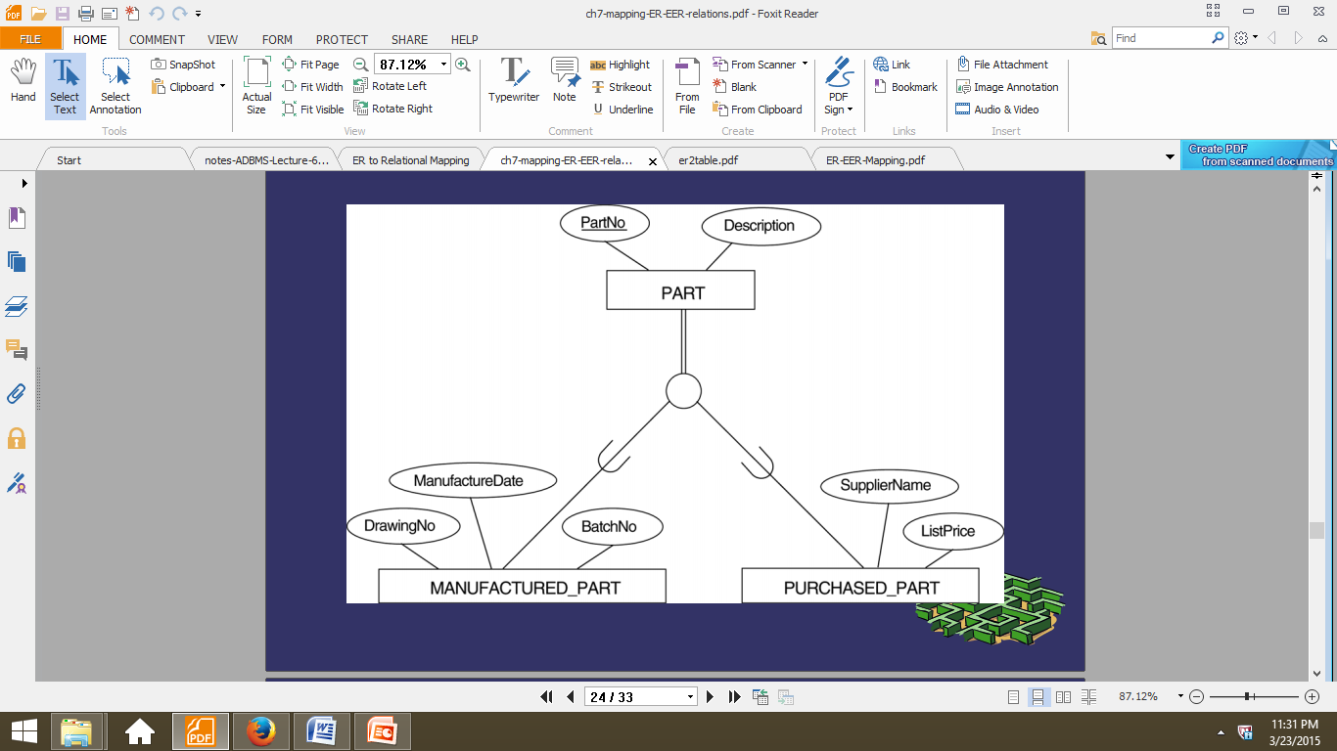
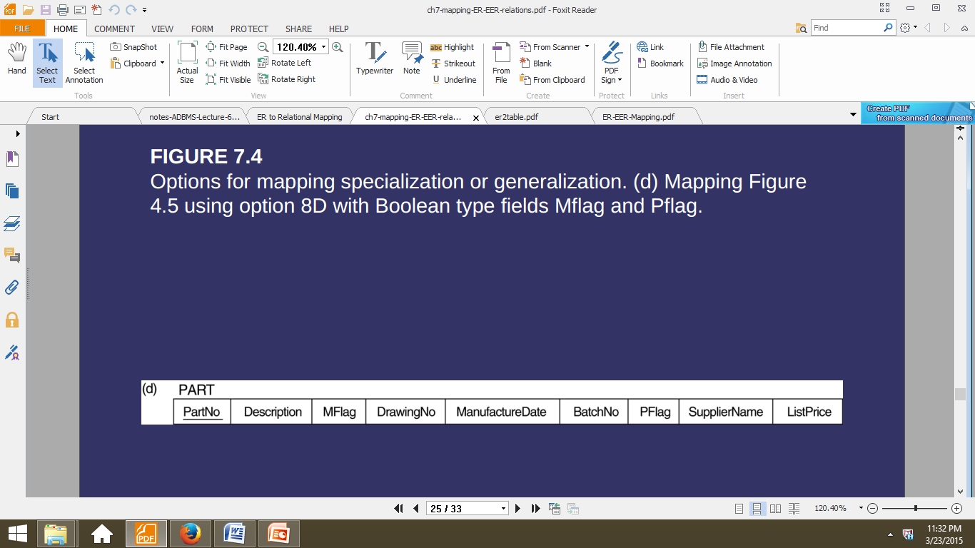
Option 8D: Single relation with multiple type attributes

Slide 36
